Slide 1
Learning Continuous Image Representation with Local Implicit Image Function CVPR2021

Slide 2
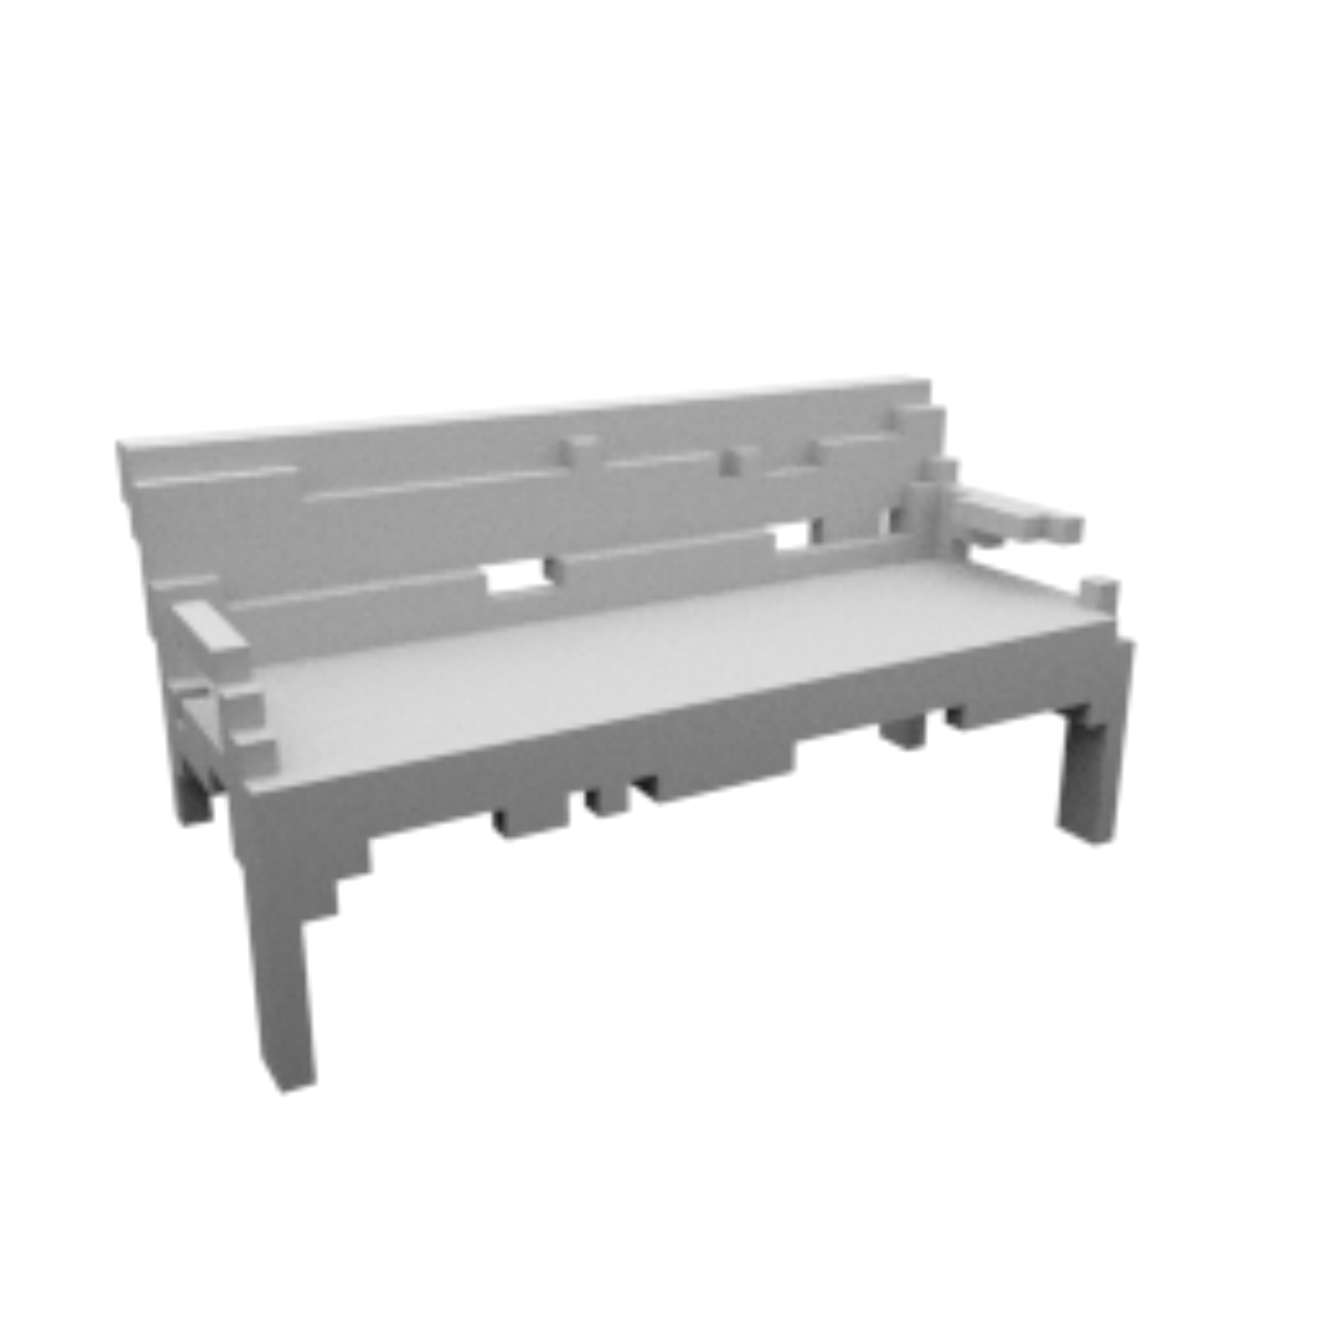
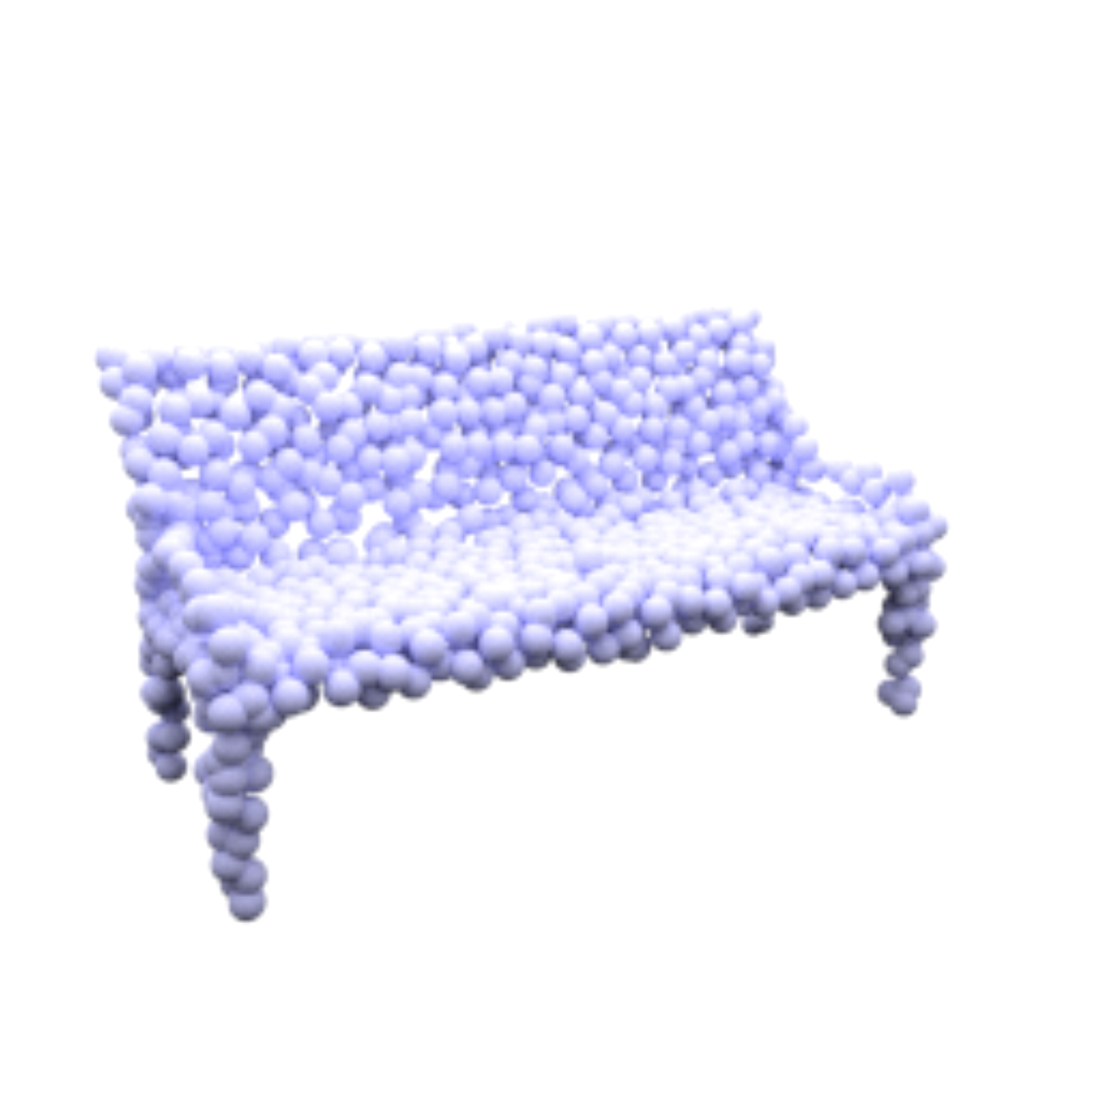
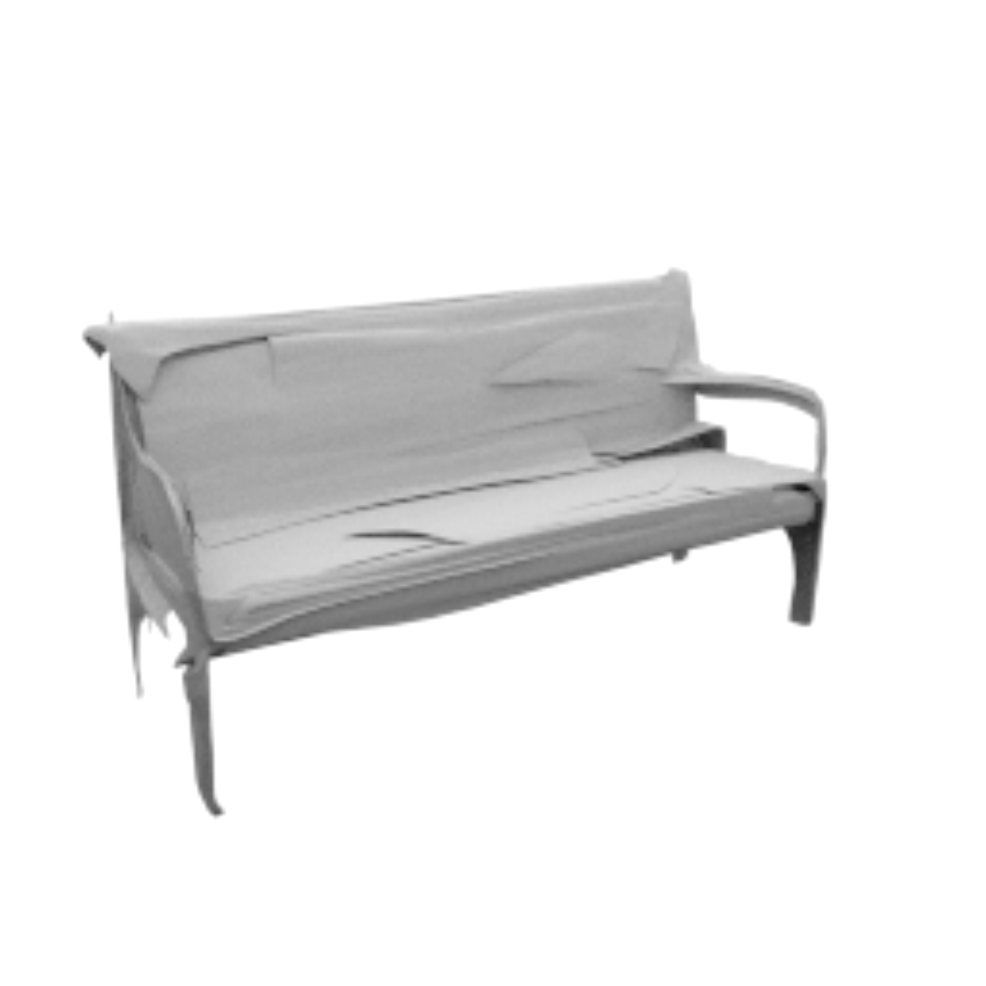
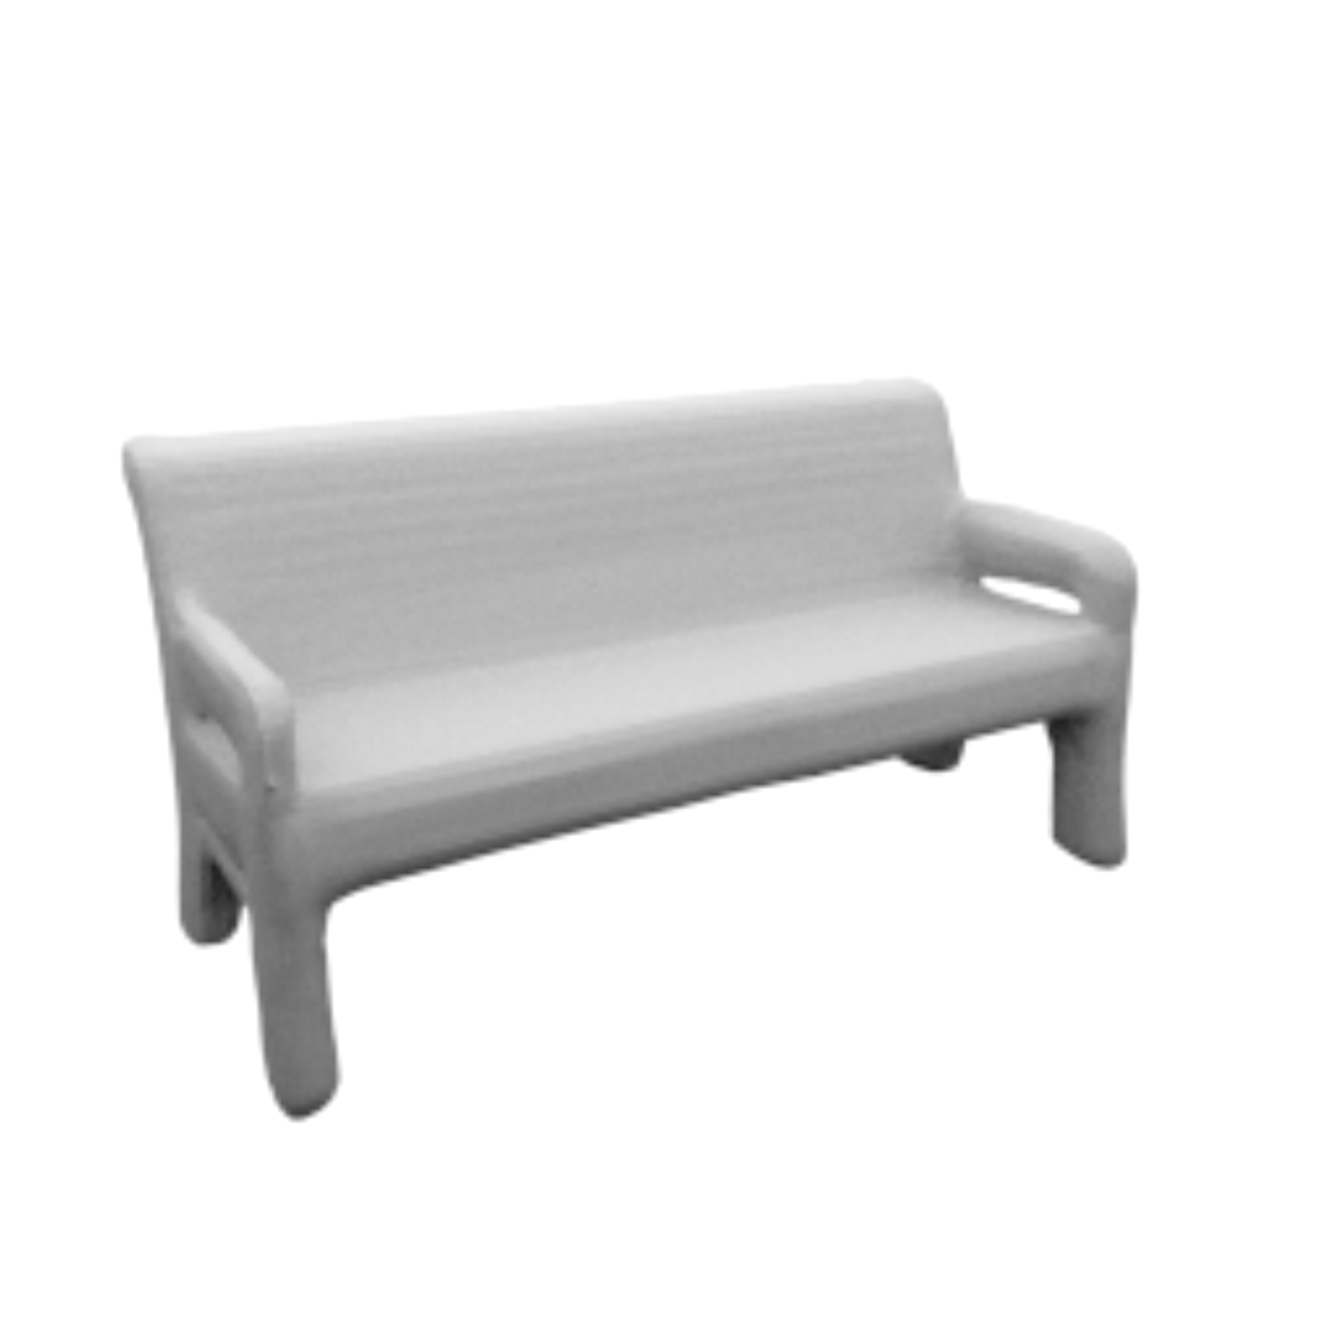
Explicit Representation
3D
2D
Point Cloud
Voxel
Mesh
Image

Slide 3
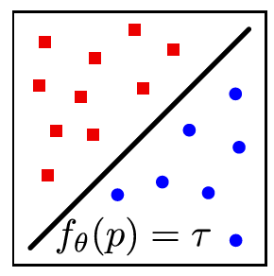
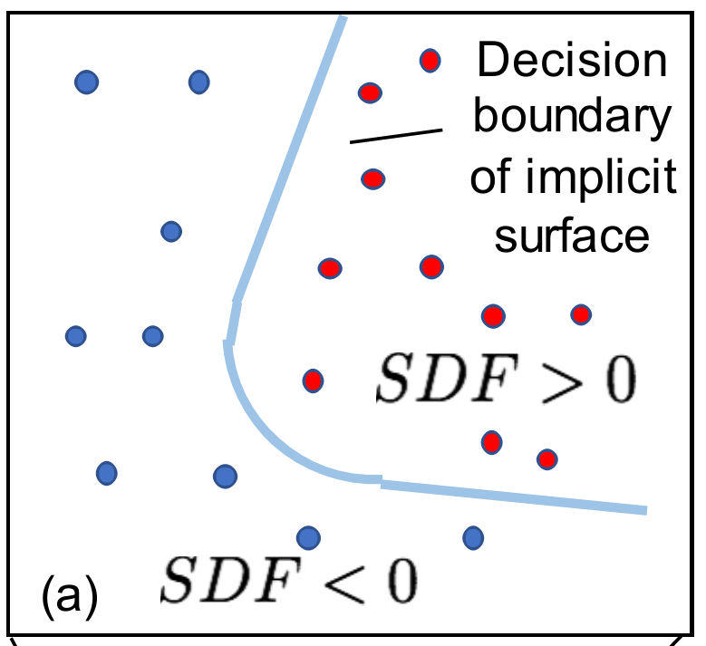
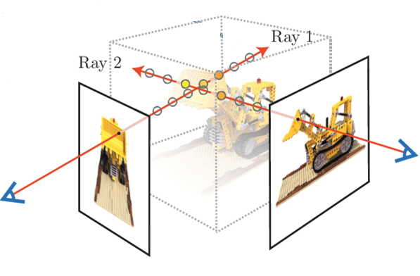
Implicit Representation
Occupancy Function
[occupancy network]
Signed Distance Field
[DeepSDF]
Neural Radiance Field
[Nerf]

Slide 4
Implicit Representation
Spatial Field: Continuous
Implicit definition：Marching Cube
Occupancy Function:(0 or 1)
Query:
x, y, z
(Direction)
SDF: Distance to the nearest surface
NeRF: Intensity and RGB
Notes:
因为是场的表达，因此在空间中是连续，处处有值
无法直接获取3D形状，需要某些后处理才能得到

Slide 5

Implicit Representation on 2D?
Notes:
然后就很自然的想到能不能把这种隐式的表达迁移到2D图像上，本身图像就应该是一个连续的信号，只是因为我们获取图片的方式以及为了方便计算机处理，使用了栅格化的操作，也就是我们经常处理的矩阵形式，

Slide 6
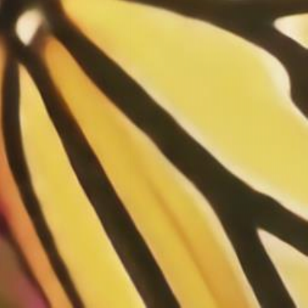

Notes:
那这种连续的表达有什么用呢，或者说为什么要把离散的表达转化为连续的表达，一个最直观的应用就是：图像超分辨，因为这种连续表达不受分辨率的限制

Slide 7
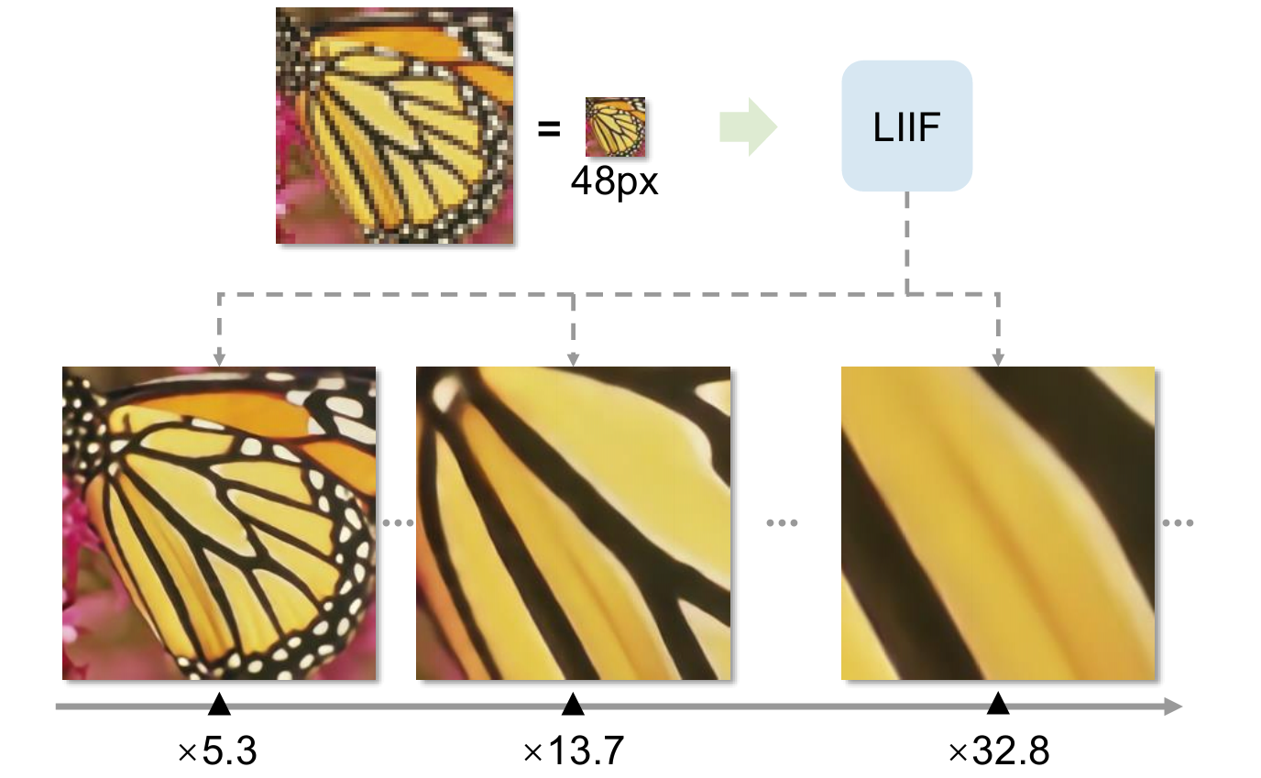
Notes:
这篇论文的就是基于这种想法，提出了一种网络结构能够将一幅图像转化到连续的表达，理想情况下可以表示任意高分辨率的图像

Slide 8

Occupancy Function:(0 or 1)
Query:
x, y, z
(Direction)
SDF: Distance to the nearest surface
NeRF: Intensity and RGB
Query:
x, y
RGB
Notes:
类比3D空间的隐式表达，其实很容易的可以想到把3D空间的query换成2D空间的query，然后把网络的输出改成图像的RGB值，这样，当x，y在2D空间中连续变化的时候，就可以得到对应的RGB输出

Slide 9
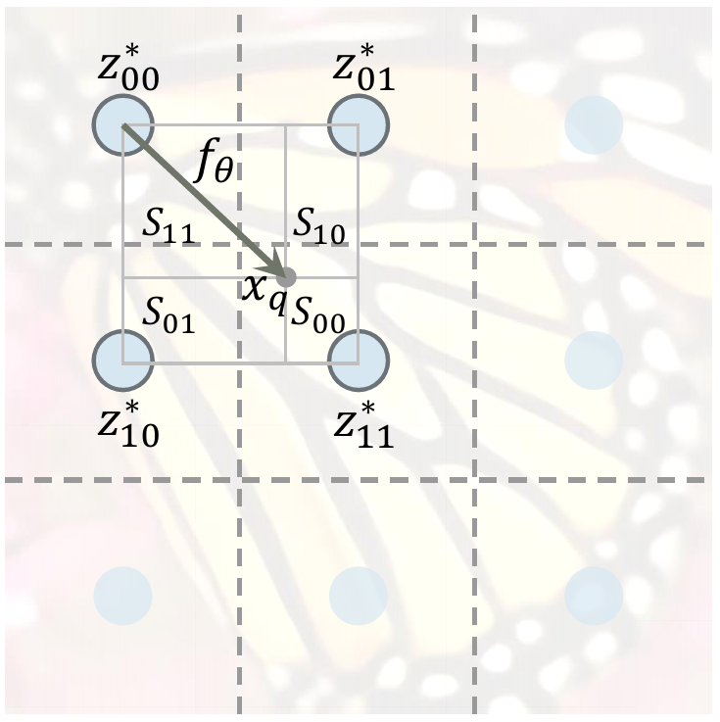
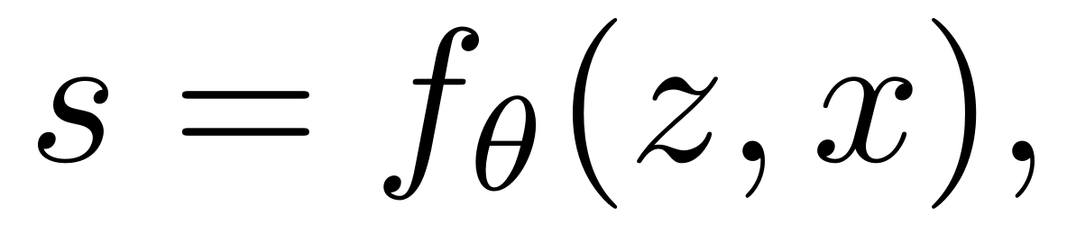
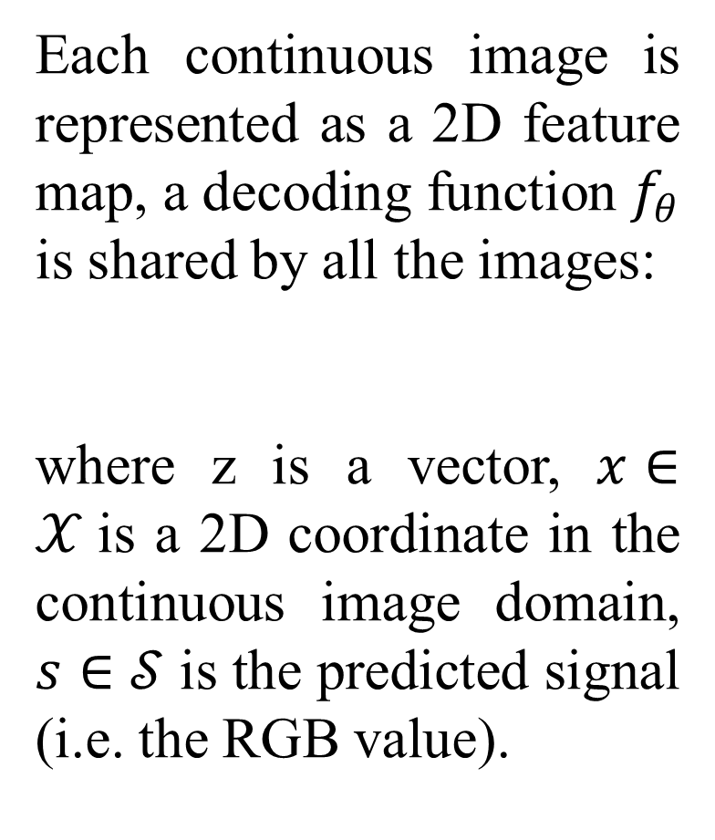
Each continuous image is represented as a 2D feature map, a decoding function $f_{θ}$ is shared by all the images:
where z is a vector, $x∈𝒳$is a 2D coordinate in the continuous image domain, $s∈𝒮$ is the predicted signal (i.e. the RGB value).

Slide 10
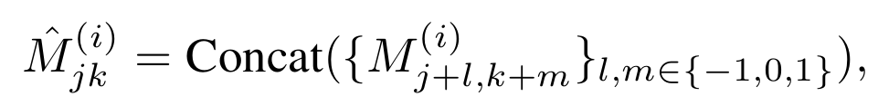
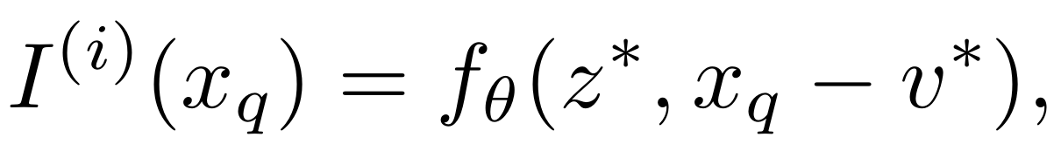
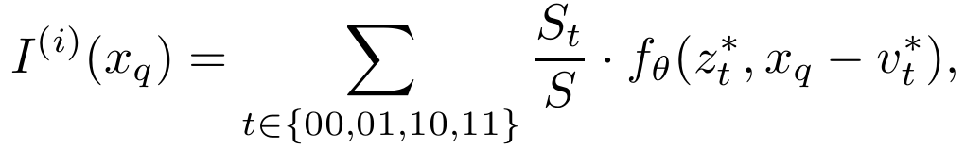
Feature unfolding. To enrich the information contained in each latent code. A latent code in ${\hat{M}}^{(i)}$is the concatenation of the $3×3$neighboring latent codes in $M^{(i)}$.
Local ensemble.

Slide 11
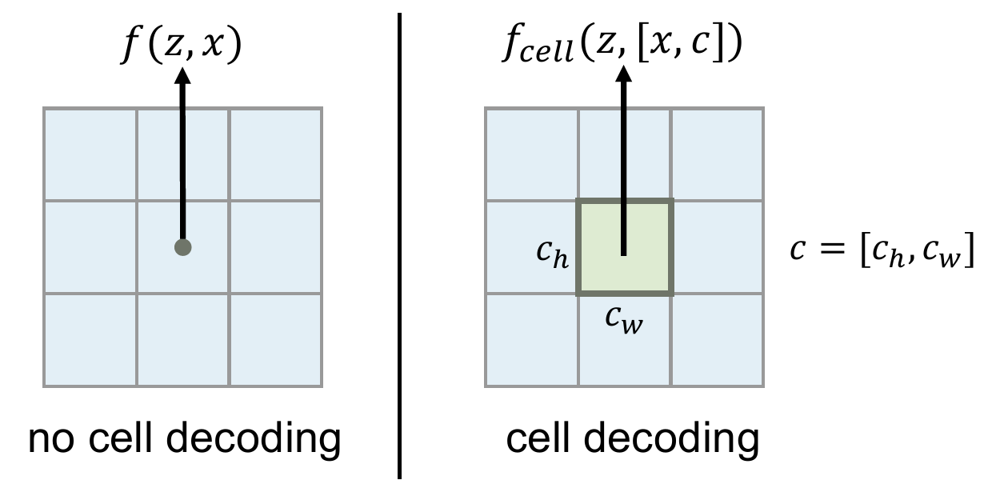
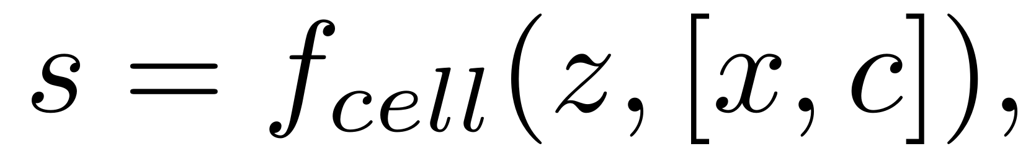
Cell decoding.
The predicted RGB value of a query pixel is independent of its size, the information in its pixel area is all discarded except the center value.

Slide 12
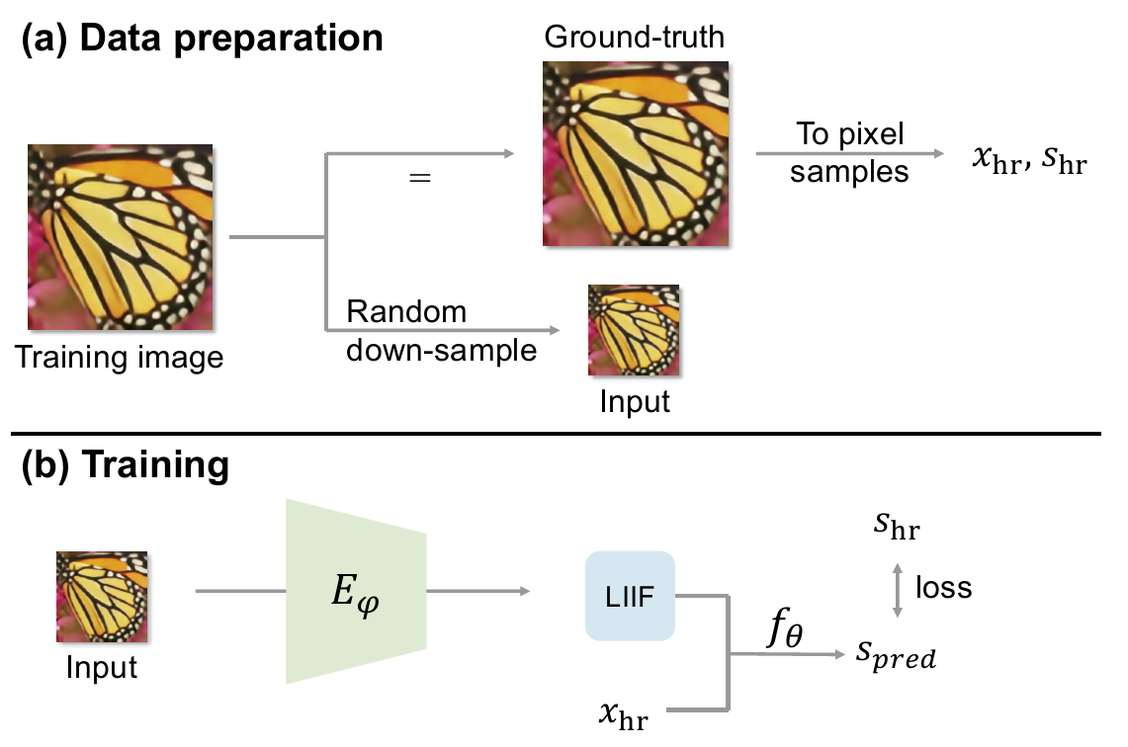

Slide 13
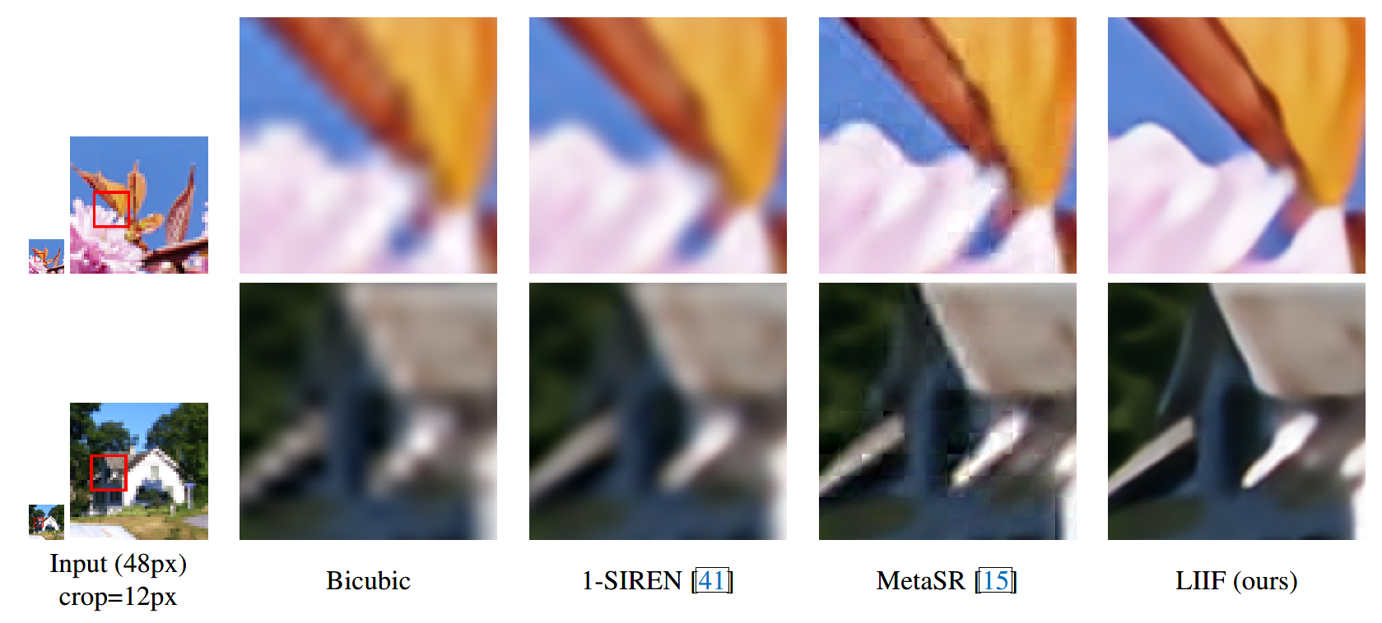

Slide 14
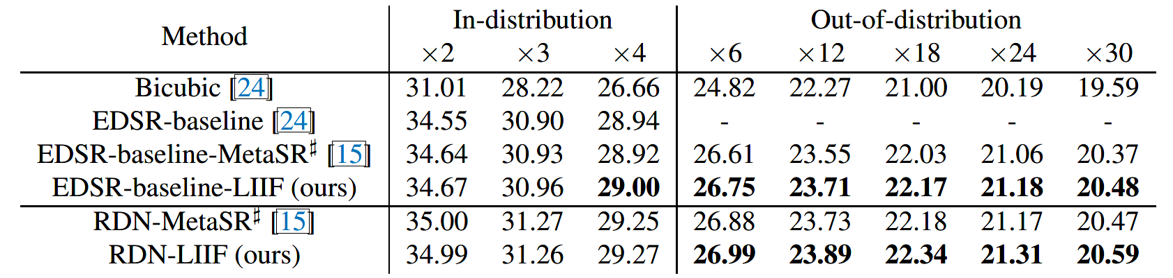
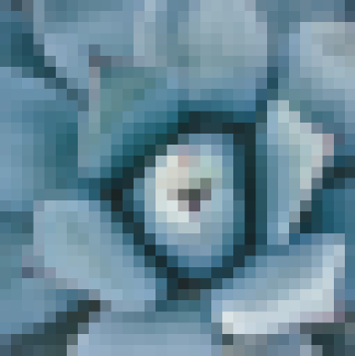

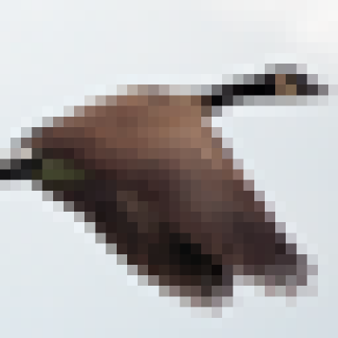

Input (32px)
LIIF (640px)
Input (32px)
LIIF (640px)

